Slide 1
Human Nature in the Old Testament Dr. Stephanie Spoto Monterey Peninsula College
Gentrain
19 September 2018

Slide 2
Genesis
Genesis, Hebrew Bereshit (“In the Beginning”), the first book of the Bible.
Its name derives from the opening words: “In the beginning….”
Genesis narrates the primeval history of the world (chapters 1–11) and the patriarchal history of the Israelite people (chapters 12–50).
The primeval history includes the familiar stories of the Creation, the Garden of Eden, Cain and Abel, Noah and the Flood, and the Tower of Babel.
The patriarchal history begins with the divine promise to Abraham that “I will make of you a great nation” (12:2) and tells the stories of Abraham (chapters 12–25) and his descendants: Isaac and his twin sons Jacob and Esau (chapters 26–36) and Jacob’s family, the principal figure being Joseph (chapters 37–50), whose story tells how the Israelites came to be in Egypt.
Their deliverance is narrated in the following book of Exodus. Genesis must thus be seen as a part of a larger unit of material traditionally understood to comprise the first five books of the Bible, called the Torah or the Pentateuch.
“Genesis,” Encyclopædia Britannica, April 11, 2016, Accessed September 19, 2018

Slide 3
Genesis
Scholars have identified three literary traditions in Genesis, as in Deuteronomy, usually identified as the Yahwist, Elohist, and Priestly strains.
The Yahwist strain, so called because it used the name Yahweh (Jehovah) for God, is a Judaean rendition of the sacred story, perhaps written as early as 950 BCE.
The Elohist strain, which designates God as Elohim, is traceable to the northern kingdom of Israel and was written 900–700 BCE.
The Priestly strain, so called because of its cultic interests and regulations for priests, is usually dated in the 5th century BCE and is regarded as the law upon which Ezra and Nehemiah based their reform.
Because each of these strains preserves materials much older than the time of their incorporation into a written work, Genesis contains extremely old oral and written traditions.
“Genesis,” Encyclopædia Britannica, April 11, 2016, Accessed September 19, 2018

Slide 4
Old Testament History
Before 4000 BC | The Creation | Genesis 1
Before 4000 BC | The Garden of Eden | Genesis 2
Before 4000 BC | The Fall of Man | Genesis 3
Before 3000 BC | Cain kills Abel | Genesis 4
Before 2500 BC | The Great Flood | Genesis 7
Before 2100 BC | The Tower of Babel | Genesis 11
2080 BC | Ishmael Born | Genesis 16:15
2067 BC | The Destruction of Sodom | Genesis 19
1928 BC | Jacob's vision of a ladder | Genesis 28:10
1539 BC | Pharaoh's Order to Kill Firstborn | Exodus 1:22
1446 BC | The Ten Plagues on Egypt | Exodus 7 - 12
1446 BC | The Exodus Begins | Exodus 13 – 18
1406 BC | The Death of Moses | Deuteronomy 34
1024 BC | David Kills Goliath | 1 Samuel 17
966 BC | The Ark Brought to the Temple | 1 Kings 8
725 BC | Isaiah Prophesies against the Nations | Isaiah 13 – 22
582 BC | Nebuchadnezzar’s Dream | Daniel 4
444 BC | People Settle in Jerusalem | Nehemiah 11, 12

Slide 5
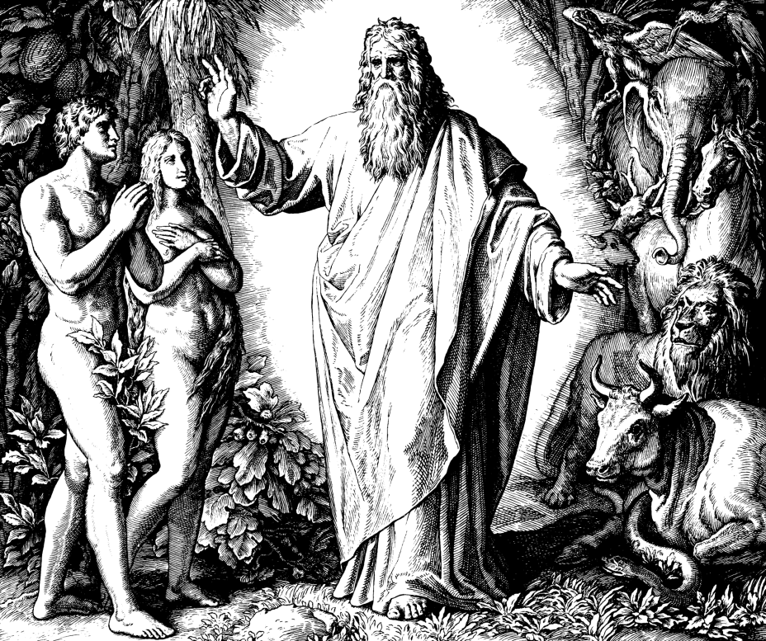
Humans in relation to God and Universe Creation as history or metaphor?
“Let us make human beings in our image, after our likeness, to have dominion over… all wild animals” (Gen. 1:26)
History: representing events that took place in particular time and place
Mythology: more poetic expression of truths of human condition
Difficulties when seeking truth in the text:
Inconsistencies in text: Gen I & Gen II
Introduction of science: different/contradictory accounts of the universe’s creation
“Common sense”: How did the children of Adam and Eve reproduce?
Woodcut for "Die Bibel in Bildern", 1860.

Slide 6
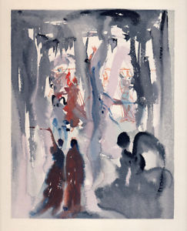
In God’s image
What does it mean that we were created in God’s image?
Unique – with rationality and something of the sacred spirit of God?
Or do we impose that perfection from our own imperfection? An idealization of our own imperfect morality/rationality?
Imperfectly rational beings, social, individual persons, freedom of choice, loving relationships, self-awareness → but also the capacity for vice, hatred, greed, etc.
Does this reflect God?
Salvador Dali, “The Divine Comedy” - Paradisio

Slide 7
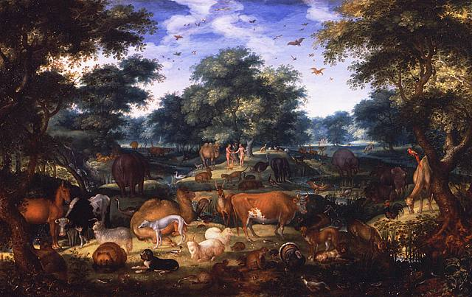
Dominion over the animals Human, nature, and hierarchy
In the Middle East at the time of Genesis, humans had already developed agriculture → animal domestication
Adam names the animals (Gen. 2:20)
Can naming be a kind of power? The power of language?
God speaks to humans: to Adam and Eve, Moses, Noah, Jacob, Joshua, Elijah, Job
Language is something that binds humans and God → commonality
Jacob Savery the Elder, “The Garden of Eden” 1601

Slide 8
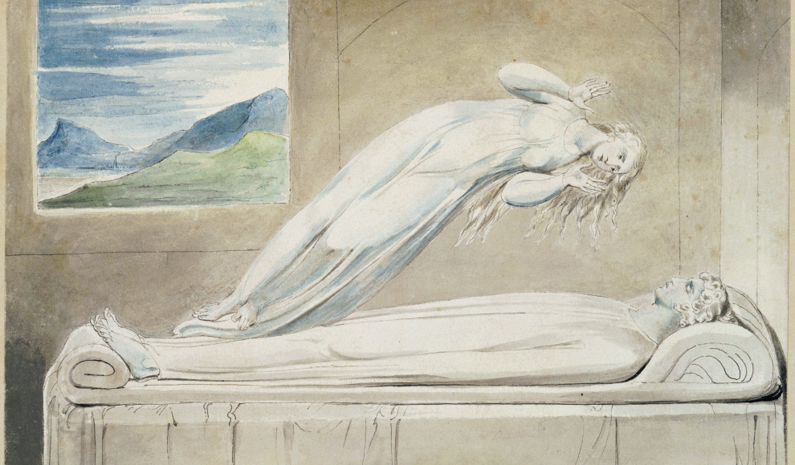
Connection with nature
The Soul hovering over the Body (c. 1805-1808)
William Blake
Separate from nature? Or part of nature?
Humans first made of “dust from the ground” (Gen. 2:7)
“God breathed into his nostrils the breath of life.”
Is this literal? Does God breath? Is he embodied?
Hebrew word sometimes translated as spirit, ruach → breath, wind
Not the Platonic soul, but bodily function
Soul/Body dualism:
When we look for evidence of this dualism, we are looking for an idea that is Platonic and not found in the Old Testament
Plato/Descartes have so influenced our understanding of our connection between soul and body that we often read it into scripture.

Slide 9
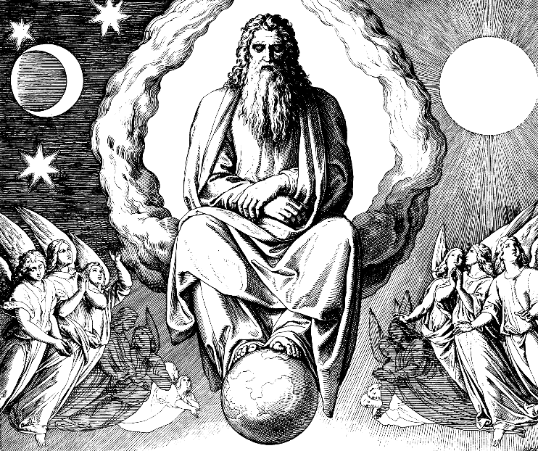
God and Materiality
God is a person → has agency, and individuality
Speaks face-to-face with Moses, as one man to another: “The Lord would speak to Moses face to face, as one speaks to a friend” (Ex. 33:11)
Not meant to take this literally → metaphor → beyond scientific postulates like space, time, and materiality (Psalm 90:2, Romans 1:20)
Woodcut for "Die Bibel in Bildern", 1860.
God also is not mere abstraction
Numbers, shapes, etc.
He is a personal being → love, anger, forgiveness, intention, agency

Slide 10
God (dis)embodied
God has power to change physical events → but conceived of as non-physical
Conception of God meant to impact our understanding of ourselves and ourselves as moral agents
Not embodied → God doesn’t literally “face” Moses, but somehow disembodied with superhuman qualities
Someone better and greater than anything conceivable
Does this fall into some kind of metaphysical abstraction?
We can, of course, say some relevant words that point to something, but they are not representative of that vastness
These words point to something that is hidden → beyond comprehension

Slide 11
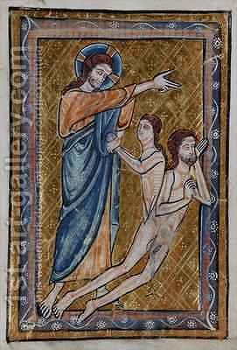
Textual ambiguity Women, sin, and nature
Two version of creation (Gen I&II)
Eve’s temptation
Women more prone to sin, sexuality → Adam and Eve’s nakedness after the fall
God punishes Eve → patriarchal submission
Women lower on the scala naturae
closer to animals more material, less intellectual
The Creation of Adam and Eve from a Book of Hours by William de Braile
c. 1230 – c. 1260, England

Slide 12
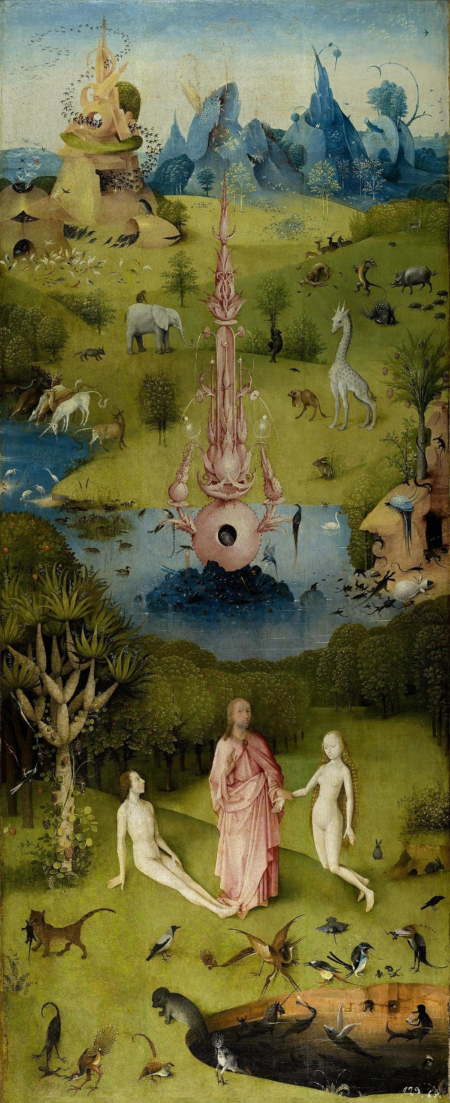
Will and Freedom
Central to understanding of human nature in the Old Testament
Conceived of as choice between obedience and disobedience:
Obedience: faith, love of God
Disobedience: pride, disavowal, faithlessness
Tree of knowledge → shouldn’t this be good?
Greek value in intellect vs. Judeo-Christian notion of human goodness
God rewards Abraham for being willing to sacrifice his own son (Gen 22)
The triumph of faith and obedience over reason

Slide 13
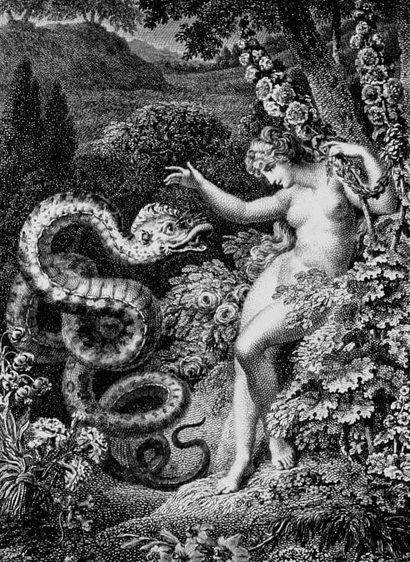
“Free to Fall”
“The Guileful Serpent Persuades Eve”
Edward Burney, c. 1780
For man will heark'n to his glozing lyes,
And easily transgress the sole Command,
Sole pledge of his obedience: So will fall,
Hee and his faithless Progenie: whose fault?
Whose but his own? ingrate, he had of mee
All he could have; I made him just and right,
Sufficient to have stood, though free to fall.
- John Milton, Paradise Lost, Book 3
and wherein lies Th' offence, that Man should thus attain to know? What can your knowledge hurt him, or this Tree Impart against his will if all be his? Or is it envie, and can envie dwell In Heav'nly brests? these, these and many more Causes import your need of this fair Fruit. Goddess humane, reach then, and freely taste.
-John Milton, Paradise Lost, Book 9

Slide 14
Human Disobedience The Misuse of Freedom
Using this conception of human nature (created by God), we can understand the faults of humanity:
Mis-use of free-will → gift from God
Chose evil rather than good → interrupts relationship with God
Suffering the consequences of the mis-use of this God-given freedom
God’s covenants (quasi-legal agreements) restore humanity through His forgiveness
Noah (Gen 9); Abraham (Gen 17); Moses (Ex 19)
However, sin does not vanish from humanity → promise of both punishment but also forgiveness → promise of a savior

Slide 15
Sources
Cohen, Jeremy. “Original Sin as the Evil Inclination. A Polemicist's Appreciation of Human Nature.” The Harvard Theological Review, 1980, Vol. 73 (3/4), pp. 495-520.
“Genesis,” Encyclopædia Britannica, April 11, 2016, Accessed September 19, 2018.
Milton, John. Paradise Lost. Ed. S. Orgel. OUP, 2004.
Stevenson, Leslie and David L. Haberman. Ten Theories of Human Nature. Fifth Edition. OUP, 2009.
Ward, Keith. Religion and Human Nature. Clarendon Press, Oxford, 1998.

